Slide 1
Research Project Titled:
Avail Lean Manufacturing to Abate Heart Failure Deaths with Machine Learning Prognostication
Course: ISE 251, Instructor: Dr. Behin Elahi
Presenter: Steven Ishoeebayat, Richard Lineberger, Harpreet Singh Mudhar, Sakshi Tapir, Caroline Zana
Notes:
Caroline

Slide 2
TABLE OF CONTENTS
01
02
03
04
05
06
Introduction
Literature Review
Case Study
Conclusion
Future Research
References
Notes:
Caroline

Slide 3

INTRODUCTION
Evolving healthcare market growth requires finding new ways to better patients by:
Data
Analysis
Treatment advancements
Identifying root causes, reduces waste of lean.
Notes:
Caroline

Slide 4
1.1 PROCESS IMPROVEMENT TECHNIQUES
1. Tools and Techniques
Python & Machine Learning:
Used to analyze large datasets, predict outcomes (e.g., heart failure events),
Algorithms: Logistic Regression, Correlation Analysis.
Minitab:
Data Visualization: Graphs and charts to spot trends and monitor key metrics.
Logistic Regression: Predicting binary outcomes like death event due to heart failure.
2. Lean Techniques
Maximizing Value, Minimizing Waste:
Purpose: Eliminate waste while maximizing value for patients through continuous improvement.
Core Principles:
Kaizen: Continuous, incremental improvement.
5S(Sort, Set in order, Shine, Standardize, Sustain): Organizing workspaces to enhance efficiency.
Healthcare Application:
Improving clinical processes (e.g., patient discharge, medication administration).
Reducing the likelihood of death events due to heart failure and improving overall care efficiency.

Slide 5

2. LITERATURE REVIEW & SIGNIFICANCE OF THE PROBLEM

Slide 6
💔 Heart Failure Mortality Crisis
Cause of death globally, with severe complications leading high mortality rates.
1 in 5 patients with heart failure dies in a year of diagnosis.
2.1 Significance of The Problem
Prevent the preventable
Optimize resources: Focus on high-risk patients, reduce unnecessary hospital stays, and improve quality of life.
🏥 Strain on Healthcare Systems
🚑 Why Early Prediction Matters
Billions annually spent on hospitalizations and readmissions.
Pressure on resources

Slide 7
2.2 STUDIED RESEARCH PAPERS
Literature Review is organized in four categories:
Statistical Review & Meta-Analysis
Machine Learning
Risk Prediction Modeling
Waste Reduction

Slide 8
2.2 STUDIED RESEARCH PAPERS
Category | Number of Papers
Reduction Statistical Review & Meta-Analysis | 16
Machine Learning | 4
Risk Prediction Modeling | 9
Waste Reduction | 1

Slide 9
2.2 STUDIED RESEARCH PAPERS
The peer-reviewed literature studied include the following techniques discussed in class to identify significant factors that lead to increased heart failure:
Lean Techniques & Methodologies
Statistical Data Analytics & Statistical Process Control
Industry 5.0 Tools

Slide 10
2.2.1 Machine Learning & Statistical Review of Major Factors
Research by Chicco, D. et al. (2020)
Idea: Analysis of medical records of 299 patients in Punjab, Pakistan
Objective: Determine the significant factors that can be monitored
to prevent or reduce heart failure
Techniques: Biostatistical Analysis & Machine Learning
Result: Both biostatistical analysis and machine learning yield identical results, serum creatinine and ejection fraction are both major factors signaling heart failure

Slide 11
2.2.1 Statistical Analysis of Follow-Up Period
Research by Lee, K.K. et al. (2016)
Idea: Analysis of 11,985 eligible Kaiser Permanente patients hospitalized due to heart failure
Objective: Determine ideal follow-up period post-discharge that reduces readmission of heart failure patients
Techniques: Logistic Regression Analysis
Result: Readmission unadjusted risk: contacted within 1-7 days is 12%, contacted within 8-30 days is 8.9%, no contact is 29.3%

Slide 12
2.2.1 Statistical Test of Serum Sodium Relationship
Research by Peng, S. et al. (2022)
Idea: Analyze 5,002 male patients between 58-86 years old
Objective: Identify relationship between serum sodium and chronic heart failure rate
Techniques: Pearson’s Chi-squared Test
Result: U-shaped 95% confidence interval after smoothing graph, lowest mortality rate at 137.5 mmol/L, increased risk of heart failure below and multiplied risk of heart failure above

Slide 13
2.2.1 Increased Chances of Heart Failure With Age
Research by Strait, J.B. et al. (2022)
Idea & Objective: Educate on increased risk of heart failure with age
Techniques: Literature Review
Result: Structural & functional changes, cardio protection & repair process, increased cardiovascular disease incidence & prevalence, systemic disease/other organ systems

Slide 14


Heart Failure Clinical Records
Case Study

Slide 15
PROBLEM DEFINITION
For this project, we aim to leverage the principles of Lean and Six Sigma to improve the prediction of heart failure by analyzing 12 factors that potentially affect heart failure outcomes. Our focus will be on reducing the 8 wastes of Lean, specifically targeting waiting, motion, and extra processing, through the use of Minitab and machine learning. We will identify which of these factors significantly contribute to heart failure predictions, utilizing both statistical methods and machine learning models.

Slide 16
PROPOSED METHODOLOGY
Minitab: Correlation between each predictor variable with the response variable
Correlation threshold: 0.1
Minitab: Create logistic regression model with predictor variables that have a high correlation with the response variable
R-Squared threshold: 50%
Python: Machine Learning Algorithms
Multi-layer Perceptron
Decision Tree
Support Vector Machine

Slide 17

PROJECT IMPLEMENTATION
& ACHIEVED GOALS 🎯
Notes:
Caroline

Slide 18
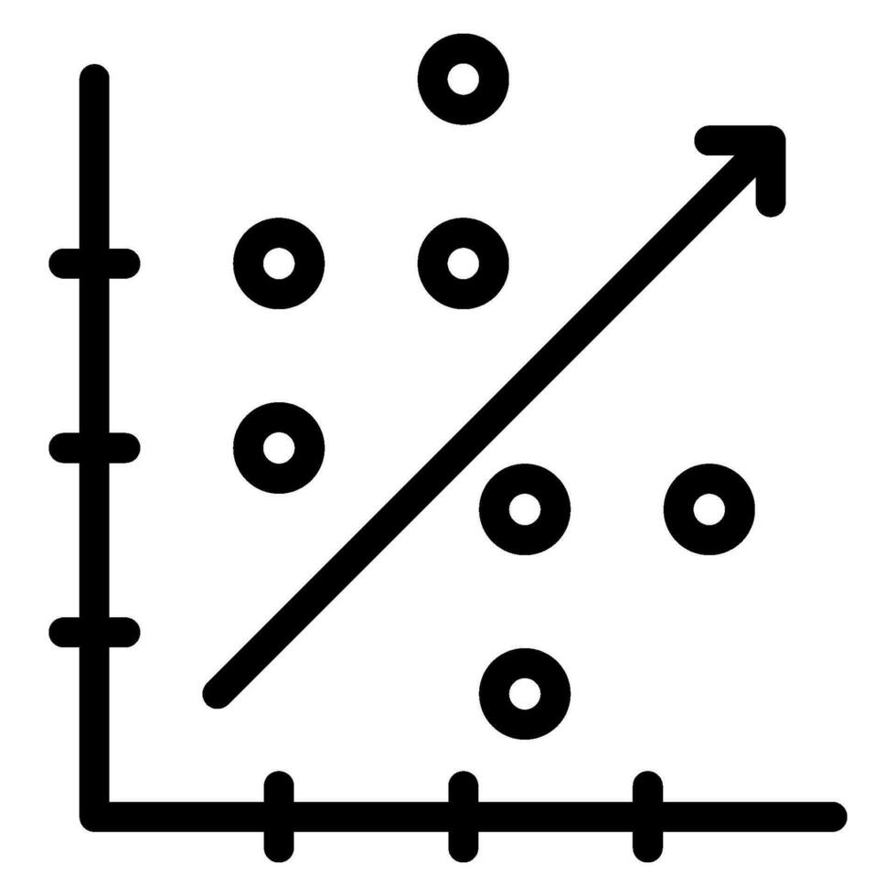
Optimal Correlation Threshold
Correlation measures the strength/ direction of a linear relationship between two variables
+1: Perfect positive correlation
(as one increases, the other increases).
−1: Perfect negative correlation
(as one increases, the other decreases).
Threshold of 0.1 = 10%
Notes:
Caroline

Slide 19
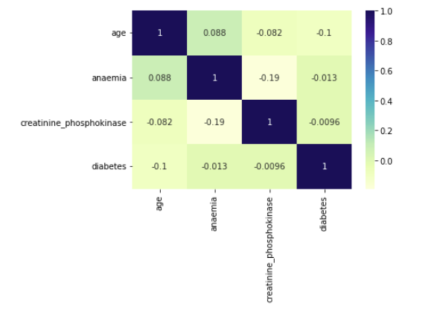
Correlation - Python

Slide 20
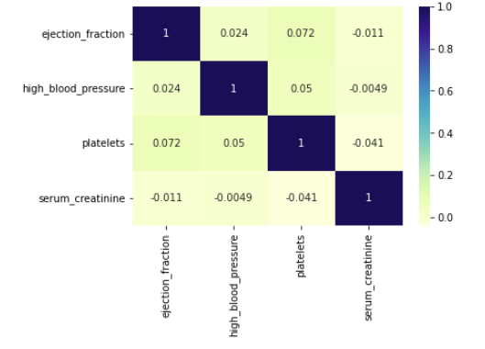
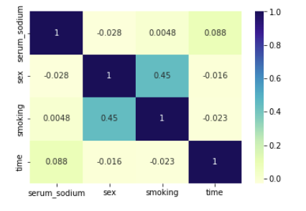
Correlation - Python

Slide 21
Regression Model Setup - Minitab
Predictor | Correlation | Reason
Age | +0.254 (Moderate Positive) | Relevant and moderately related to death event.
Serum Creatinine | +0.294 (Moderate Positive) | Strong correlation, clinically significant.
Ejection Fraction | -0.269 (Moderate Negative) | Critical in heart failure risk assessment.
Time (Follow-up) | -0.527 (Strong Negative) | Strong and meaningful factor.
Serum Sodium | -0.195 (Weak Negative) | Clinically relevant despite weak correlation
Excluded Predictors | Correlation | Reason
Anaemia | +0.066 (Weak Positive) | Very weak correlation.
Creatinine Phosphokinase | 0.063 (Weak Positive) | Very weak correlation.
Diabetes | -0.002 (Extremely Weak) | Negligible correlation.
High Blood Pressure | +0.079 (Weak Positive) | Weak correlation.
Platelets | -0.049 (Extremely Weak) | Negligible correlation.
Sex | -0.004 (Negligible) | Negligible correlation.
Smoking | -0.013 (Very Weak Negative) | Very weak negative correlation.

Slide 22
Regression - Minitab
1. Problem Type
Binary Response Variable: The outcome we're trying to predict is binary:
DEATH_EVENT:
1 = Event (Death)
0 = No Event (Survival)
Why Logistic Regression?
Perfect for predicting a binary outcome like this!
Logistic regression maps the linear combination of predictors to a probability between 0 and 1.
2. Interpretation: Odds Ratios
Easy Interpretation: Odds Ratios
Key Benefit: Logistic regression gives us odds ratios that are easy to interpret.
An odds ratio tells us how a predictor affects the odds of the event (death) happening.
Example: If a predictor's odds ratio is greater than 1, the probability of the event increases as the predictor increases.
3. Model Assumptions
Flexibility:
No Normal Distribution Requirement: Unlike linear regression, logistic regression doesn’t require predictors to be normally distributed.
Robust to Multicollinearity: Logistic regression handles correlations between predictor variables better with interrelated factors.
Why This Matters: Healthcare data can be messy and complex, but logistic regression is still reliable, even with imperfect data structures.

Slide 23
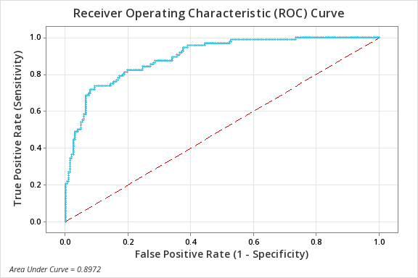
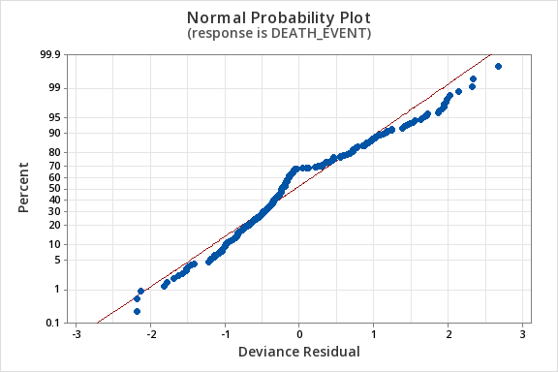
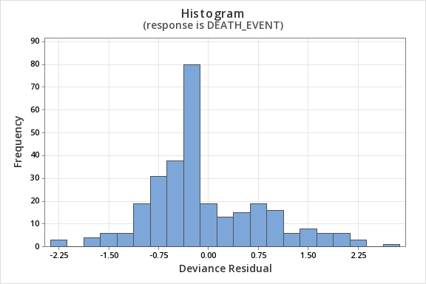
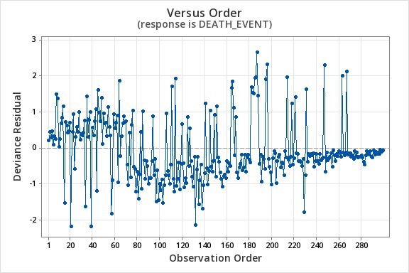
Regression Validation- Minitab
Model Validation:
Area Under ROC Curve (AUC): 0.8972 (Excellent performance)
Concordance: 89.7% (Indicates that the model is good at ranking the cases correctly in terms of predicted probabilities).
Deviance R-Square = 41.51%: R-squared values between 0.3 and 0.7 are typical, but lower values (0.0 - 0.3) are also common due to complexity of healthcare data. Hence, our model is good fit.
Goodness-of-Fit:
Hosmer-Lemeshow p-value = 0.250: The model fits the data well, as the p-value is greater than 0.05.
Pearson Chi-Square p-value = 0.875: Also confirms a good fit.

Slide 24
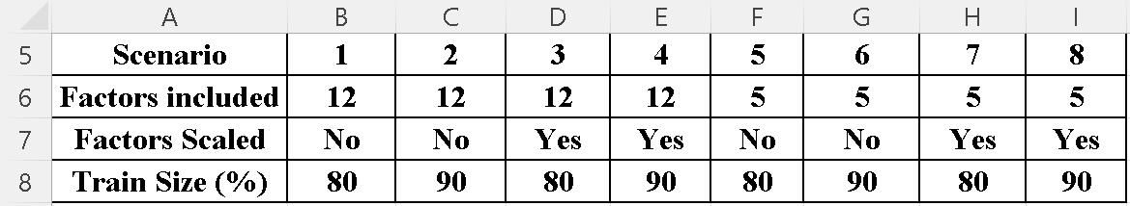
Eight initial scenarios

Slide 25
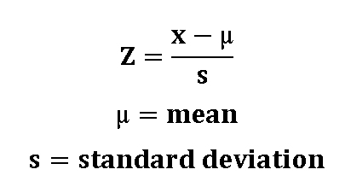
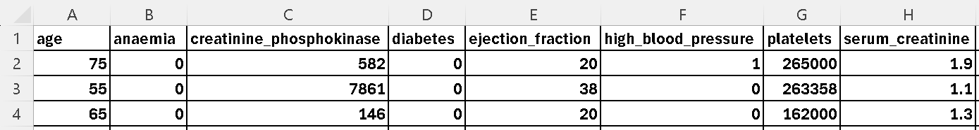
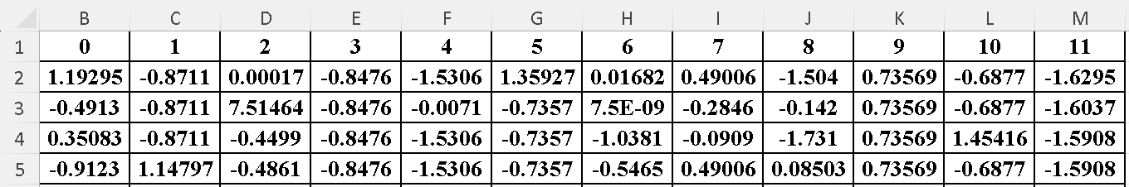
Python Standard Scaler
The original data without scaling:
The data after scaling:

Slide 26
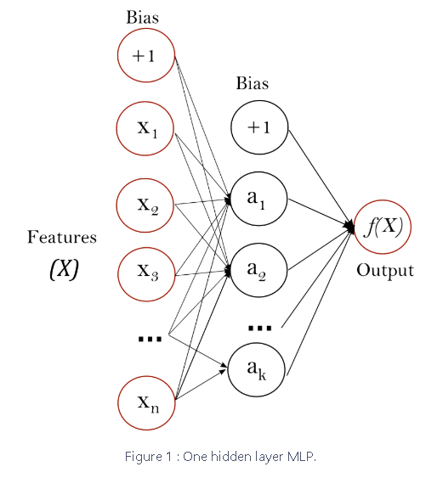
Multi-layer Perceptron (MLP)
Supervised learning
Different from logistic regression: there is a nonlinear hidden layer between the input and output layers
Hidden layer neuron: weighted linear summation
Scikit-learn

Slide 27
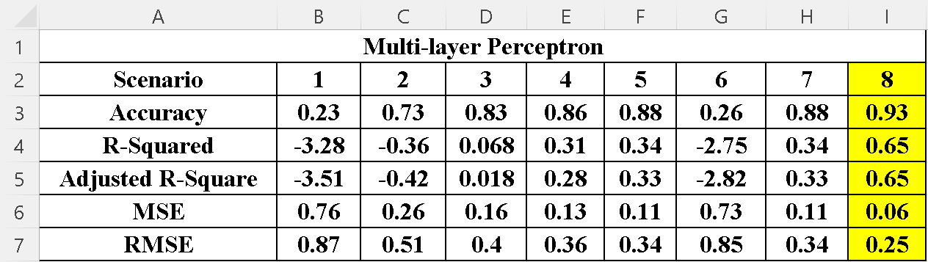
( Cont.) Machine Learning (Multi-layer Perceptron) results

Slide 28
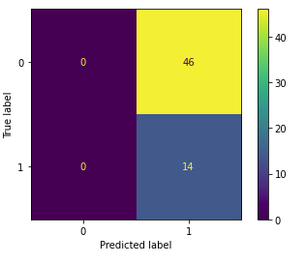
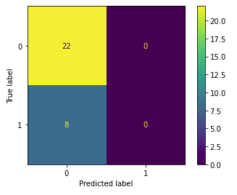
Negative Correlation
Scenario 1
Scenario 2

Slide 29
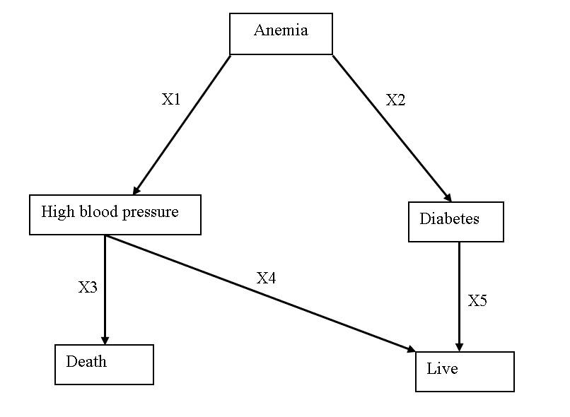
Example: Decision Tree

Slide 30
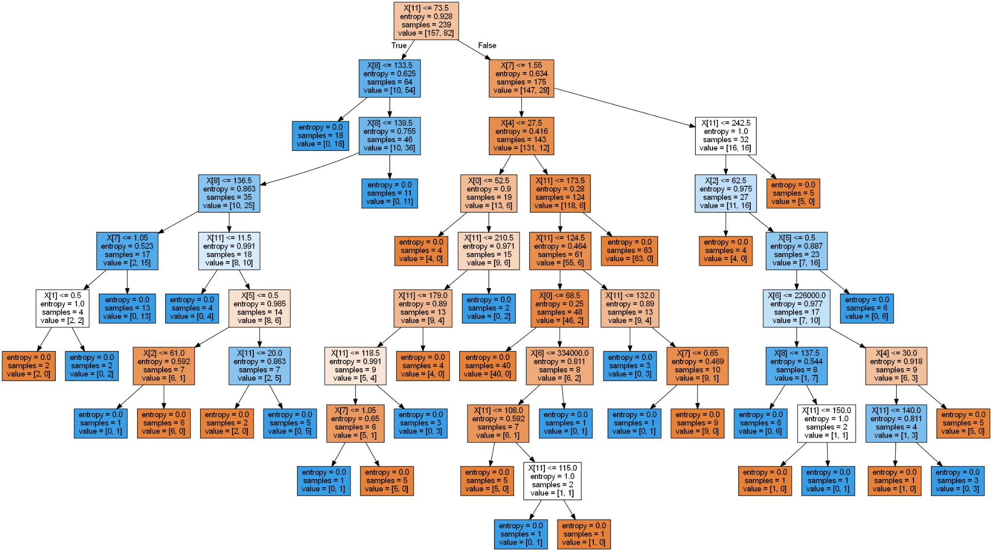
Decision Tree in Python

Slide 31
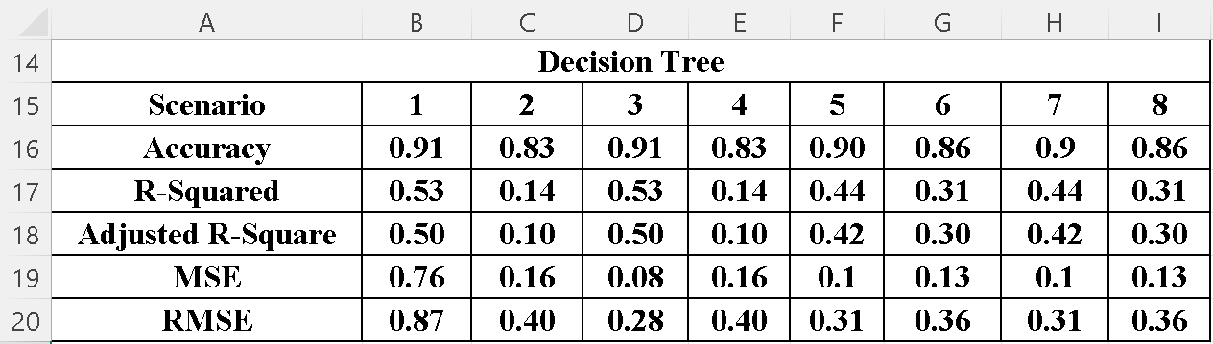
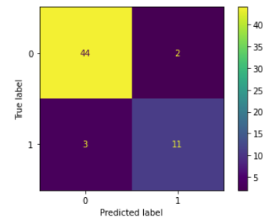
Decision Tree results
Scenario 1:

Slide 32
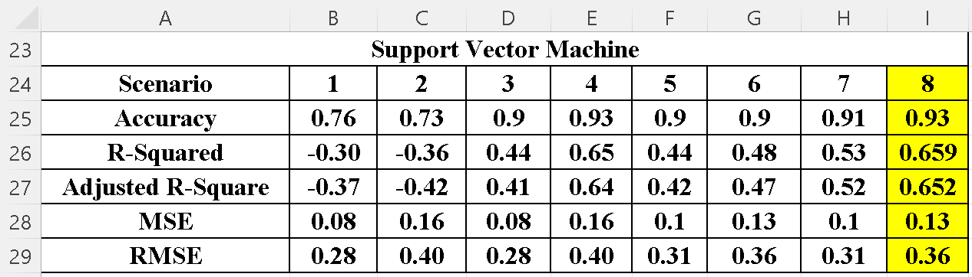
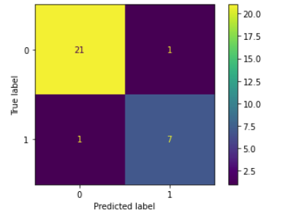
Support Vector Machine
Uses categories to separate the data
A map is used to display the categories
Scenario 8:

Slide 33
CONCLUSION
Scenario 8 from the Support Vector Machine and MLP algorithms have the highest accuracy and R-squared values
Scenario 8
Using only the 5 factors with the highest correlation with the response variable
Has standardized data
Using 90% of the data for training

Slide 34


FUTURE RESEARCH
Technological advances
Artificial intelligence
Learning overtime through human input
Learning through risks factors
See patterns that humans don't see
Evolutionary algorithms
Genetic natural selection
Notes:
Caroline

Slide 35
REFERENCES
Aune, D., Schlesinger, S., Norat, T., & Riboli, E. (2019). Tobacco smoking and the risk of heart failure: A systematic review and meta-analysis of prospective studies. European Journal of Preventive Cardiology, 26(3), 279–288. https://doi.org/10.1177/2047487318806658
Awang Kalong, N., & Yusof, M. (2017). Waste in health information systems: A systematic review. International Journal of Health Care Quality Assurance, 30(4), 341–357. https://doi.org/10.1108/IJHCQA-06-2016-0082
Bhatt, A. S., Fonarow, G. C., Greene, S. J., Holmes, D. N., Alhanti, B., Devore, A. D., Butler, J., Heidenreich, P. A., Huang, J. C., Kittleson, M. M., Linganathan, K., Joyntmaddox, K. E., McDermott, J. J., Owens, A. T., Peterson, P. N., Solomon, S. D., Vardeny, O., Yancy, C. W., & Vaduganathan, M. (2024). Medical Therapy Before, During and After Hospitalization in Medicare Beneficiaries With Heart Failure and Diabetes: Get With The Guidelines - Heart Failure Registry. Journal of Cardiac Failure, 30(2), 319-328. https://doi.org/10.1016/j.cardfail.2023.09.005
Charles, C. J., Rademaker, M. T., Scott, N. J. A., & Richards, A. M. (2020). Large Animal Models of Heart Failure: Reduced vs. Preserved Ejection Fraction. Animals, 10(10), 1906. https://doi.org/10.3390/ani10101906
Chicco, D., & Jurman, G. (2020). Machine learning can predict survival of patients with heart failure from serum creatinine and ejection fraction alone. BMC Medical Informatics and Decision Making, 20(1), 16. https://doi.org/10.1186/s12911-020-1023-5
Di Tanna, G. L., Wirtz, H., Burrows, K. L., Globe, G., & Abete, P. (2020). Evaluating risk prediction models for adults with heart failure: A systematic literature review. PloS One, 15(1), e0224135–e0224135. https://doi.org/10.1371/journal.pone.0224135
Farrington, D. K., Sang, Y., Grams, M. E., Ballew, S. H., Dunning, S., Stempniewicz, N., & Coresh, J. (2023). Anemia Prevalence, Type, and Associated Risks in a Cohort of 5.0 Million Insured Patients in the United States by Level of Kidney Function. American Journal of Kidney Diseases : The Official Journal of the National Kidney Foundation, 81(2), 201-209.e1. https://doi.org/10.1053/j.ajkd.2022.07.014
Gottdiener, J. S., Buzkova, P., Kahn, P. A., DeFilippi, C., Shah, S., Barasch, E., Kizer, J. R., Psaty, B., & Gardin, J. M. (2022). Relation of Cigarette Smoking and Heart Failure in Adults ≥65 Years of Age (From the Cardiovascular Health Study). The American journal of cardiology, 168, 90–98. https://doi.org/10.1016/j.amjcard.2021.12.021
Guichard, J., Bonno, E., Nassif, M., et al. (2024). Seated pulmonary artery pressure monitoring in patients with heart failure: Results of the PROACTIVE-HF trial. Journal of the American College of Cardiology: Heart Failure, 12(11), 1879–1893. https://doi.org/10.1016/j.jchf.2024.05.017
Hafiz, A., & Kaur, N. (2023). Heart disease prediction based on machine learning technique. 2023 IEEE 3rd International Conference on Technology, Engineering, Management for Societal Impact Using Marketing, Entrepreneurship and Talent (TEMSMET), 1–7. https://doi.org/10.1109/temsmet56707.2023.10150023
Hamid, A., Segar, M. W., Bozkurt, B., Santos-Gallego, C., Nambi, V., Butler, J., Hall, M. E., & Fudim, M. (2024). Machine learning in the prevention of heart failure. Heart Failure Reviews. https://doi.org/10.1007/s10741-024-10448-0
Notes:
Caroline

Slide 36
REFERENCES
Kajimoto, K., Minami, Y., Otsubo, S., & Sato, N. (2019). Association of admission and discharge anemia status with outcomes in patients hospitalized for acute decompensated heart failure: Differences between patients with preserved and reduced ejection fraction. European Heart Journal.Acute Cardiovascular Care, 8(7), 606-614. https://doi.org/10.1177/2048872617730039
Kao, D., Trinkley, K., & Lin, C. (2020). Heart failure management innovation enabled by electronic health records. Journal of the American College of Cardiology: Heart Failure, 8(3), 223–233. https://doi.org/10.1016/j.jchf.2019.09.008
Katari, S., Likith, T., Sree, M. P., & Rachapudi, V. (2023). Heart disease prediction using Hybrid ML algorithms. 2023 International Conference on Sustainable Computing and Data Communication Systems (ICSCDS), 121–125. https://doi.org/10.1109/icscds56580.2023.10104609
Kiuchi, S., Hisatake, S., Kabuki, T., Dobashi, S., Murakami, Y., & Ikeda, T. (2023). Importance of anemia in heart failure over blood pressure variability. Clinical Cardiology, 46(12), 14951503. https://doi.org/10.1002/clc.24141
Lee, K. K., Yang, J., Hernandez, A. F., Steimle, A. E., & Go, A. S. (2016). Post-discharge Follow-up Characteristics Associated With 30-Day Readmission After Heart Failure Hospitalization. Medical Care, 54(4), 365–372. https://www.jstor.org/stable/26418148
Luo, H., Xiang, C., Zeng, L., Li, S., Mei, X., Xiong, L., Liu, Y., Wen, C., Cui, Y., Du, L., Zhou, Y., Wang, K., Li, L., Liu, Z., Wu, Q., Pu, J., & Yue, R. (2024). SHAP based predictive modeling for 1 year all-cause readmission risk in elderly heart failure patients: Feature selection and Model Interpretation. Scientific Reports, 14(1). https://doi.org/10.1038/s41598-024-67844-7
Luo, J., Li, Z., Luo, Y., Li, T., Shi, R., Chen, D., Wu, Q., Luo, S., Huang, B., & Tie, H. (2024). Platelet count in heart failure patients undergoing left ventricular assist device. ESC Heart Failure, 11(5), 2999-3011. https://doi.org/10.1002/ehf2.14856
Matasic, D. S., Zeitoun, R., Fonarow, G. C., Razavi, A. C., Blumenthal, R. S., & Gulati, M. (2024). Advancements in Incident Heart Failure Risk Prediction and Screening Tools. The American Journal of Cardiology, 227, 105–110. https://doi.org/10.1016/j.amjcard.2024.07.014
Odrobina, I. (2024). Clinical predictive modeling of heart failure: Domain description, models’ characteristics and literature review. Diagnostics, 14(4), 443. https://doi.org/10.3390/diagnostics14040443
Olsen, C. R., Mentz, R. J., Anstrom, K. J., Page, D., & Patel, P. A. (2020). Clinical applications of machine learning in the diagnosis, classification, and prediction of heart failure. The American Heart Journal, 229, 1–17. https://doi.org/10.1016/j.ahj.2020.07.009
Peng, S., Peng, J., Yang, L., & Ke, W. (2022). Relationship between serum sodium levels and all-cause mortality in congestive heart failure patients: A retrospective cohort study based on the Mimic-III database. Frontiers in Cardiovascular Medicine, 9, 1082845. https://doi.org/10.3389/fcvm.2022.1082845
Stolfo, D., Lund, L. H., Benson, L., Lindberg, F., Ferrannini, G., Dahlström, U., Sinagra, G., Rosano, G. M. C., & Savarese, G. (2023). Real-world use of sodium-glucose cotransporter 2 inhibitors in patients with heart failure and reduced ejection fraction: Data from the Swedish Heart Failure Registry. European Journal of Heart Failure, 25(9), 1648-1658. https://doi.org/10.1002/ejhf.2971
Notes:
Caroline

Slide 37
REFERENCES
Valensi, P., & Meune, C. (2019). Congestive heart failure caused by silent ischemia and silent myocardial infarction. [Kongestive Herzinsuffizienz durch stumme Ischämie und stummen Herzinfarkt] Herz, 44(3), 210-217. https://doi.org/10.1007/s00059-019-4798-3
Vazquez-Guillamet, M. C., Vazquez, R., Micek, S. T., & Kollef, M. H. (2017). Predicting resistance to piperacillin-tazobactam, cefepime, and meropenem in septic patients with bloodstream infection due to gram-negative bacteria. Clinical Infectious Diseases, 65(10), 1607–1614. https://doi.org/10.1093/cid/cix612
Wang, J., Huang, S., Hou, J., Feng, K., Wu, H., Liu, Q., Zhou, Z., Li, H., Luo, L., Shang, L., Chen, G., & Wu, Z. (2024). Impact of heart failure and preoperative platelet count on the postoperative short-term outcome in infective endocarditis patients. Clinical Cardiology, 47(1)https://doi.org/10.1002/clc.24171
Wang, S., Zhang, Y., Qi, D., Wang, X., Zhu, Z., Yang, W., Li, M., Hu, D., & Gao, C. (2024). Age and gender mediated the association between anemia and 30-day outcomes in patients with ST-segment elevated myocardial infarction. International Journal of Cardiology.Heart & Vasculature, 51, 101377. https://doi.org/10.1016/j.ijcha.2024.101377
Yano, M., Nishino, M., Kawanami, S., Ukita, K., Kawamura, A., Yasumoto, K., Tsuda, M., Okamoto, N., Matsunaga-Lee, Y., Egami, Y., Yamada, T., Yasumura, Y., Seo, M., Hayashi, T., Nakagawa, A., Nakagawa, Y., Tamaki, S., Sotomi, Y., Nakatani, D., . . . Sakata, Y. (2024). Low-density lipoprotein cholesterol, erythrocyte, and platelet in heart failure with preserved ejection fraction. ESC Heart Failure, 11(3), 1758-1766. https://doi.org/10.1002/ehf2.14734
Strait, J. B., & Lakatta, E. G. (2012). Aging-associated cardiovascular changes and their relationship to heart failure. Heart Failure Clinics, 8(1), 143-164. https://doi.org/10.1016/j.hfc.2011.08.011
N.A. (2024). 1.17. Neural network models (supervised). Scikit-learn, https://scikit-learn.org/1.5/modules/neural_networks_supervised.html
Notes:
Caroline

Slide 38
THANK YOU
Do you have any questions?
Notes:
Caroline

